Slide 1
Week # 3
Simple Sorting Algorithms
Data Structures

Slide 2
Introduction
As soon as you create a significant database, you'll probably think of reasons to sort it in various ways.
For example, arrange names in alphabetical order, students by grade, customers by zip code.
Sorting data may also be a preliminary step to searching it.
Sorting is so important and potentially so time-consuming.
In this chapter we'll look at three of the simpler algorithms out of four: the bubble sort, the selection sort, and the insertion sort and the fourth one is merge sort

Slide 3

Cont..
For example, imagine that your kids-league baseball team is lined up on the field, the regulation nine players, plus an extra, have shown up for practice.
You want to arrange the players in order of increasing height (with the shortest player on the left), for the team picture. How would you go about this sorting process?

Slide 4

Cont..
The algorithms in this topic all involve two steps, executed over and over until the data is sorted.
1- Compare two items.
2- Swap two items or copy one item.
However, each algorithm handles the details in a different way.

Slide 5
Bubble sort (1)
The concept:
https://www.youtube.com/watch?v=yIQuKSwPlro
Bubble sort is a simple sorting algorithm. This sorting algorithm is comparison-based algorithm in which each pair of adjacent elements is compared and the elements are swapped if they are not in order. This algorithm is not suitable for large data sets as its average and worst case complexity are of Ο(n²) where n is the number of items.
Here are the rules you're following:
1. Compare two players.
2. If the one on the left is taller, swap them.
3. Move one position right

Slide 6
Bubble sort
Compare each element (except the last one) with its neighbor to the right
  If they are out of order, swap them
  This puts the largest element at the very end
  The last element is now in the correct and final place
Compare each element (except the last two) with its neighbor to the right
  If they are out of order, swap them
  This puts the second largest element next to last
  The last two elements are now in their correct and final places
Compare each element (except the last three) with its neighbor to the right
  Continue as above until you have no unsorted elements on the left

Slide 7
Example of bubble sort
Step11:
7
2
8
5
4
2
7
5
4
8
2
5
4
7
8
2
4
5
7
8
Step12:
2
7
8
5
4
2
7
5
4
8
2
5
4
7
8
2
4
5
7
8
Step13:
2
7
8
5
4
2
5
7
4
8
2
4
5
7
8
(done)
Step14:
2
7
5
8
4
2
5
4
7
8
Step15:
2
7
5
4
8

Slide 8
Code for bubble sort
public static void bubbleSort(int[] a) {
int outer, inner;
for (outer = a.length - 1; outer > 0; outer--) { // counting down
for (inner = 0; inner < outer; inner++) { // bubbling up
if (a[inner] > a[inner + 1]) { // if out of order...
int temp = a[inner]; // ...then swap
a[inner] = a[inner + 1];
a[inner + 1] = temp;
}
}
}
}

Slide 9
Analysis of bubble sort
for (outer = a.length - 1; outer > 0; outer--) {
for (inner = 0; inner < outer; inner++) {
if (a[inner] > a[inner + 1]) {
// code for swap omitted
} } }
Let n = a.length = size of the array
The outer loop is executed n-1 times (call it n, that’s close enough)
Each time the outer loop is executed, the inner loop is executed
  Inner loop executes n-1 times at first, linearly dropping to just once
  On average, inner loop executes about n/2 times for each execution of the outer loop
  In the inner loop, the comparison is always done (constant time), the swap might be done (also constant time)

Slide 10
Loop invariants
You run a loop in order to change things
Oddly enough, what is usually most important in understanding a loop is finding an invariant: that is, a condition that doesn’t change
In bubble sort, we put the largest elements at the end, and once we put them there, we don’t move them again
  The variable outer starts at the last index in the array and decreases to 0
  Our invariant is: Every element to the right of outer is in the correct place
  That is, for all j > outer, if i < j, then a[i] <= a[j]
  When this is combined with the loop exit test, outer == 0, we know that all elements of the array are in the correct place

Slide 11
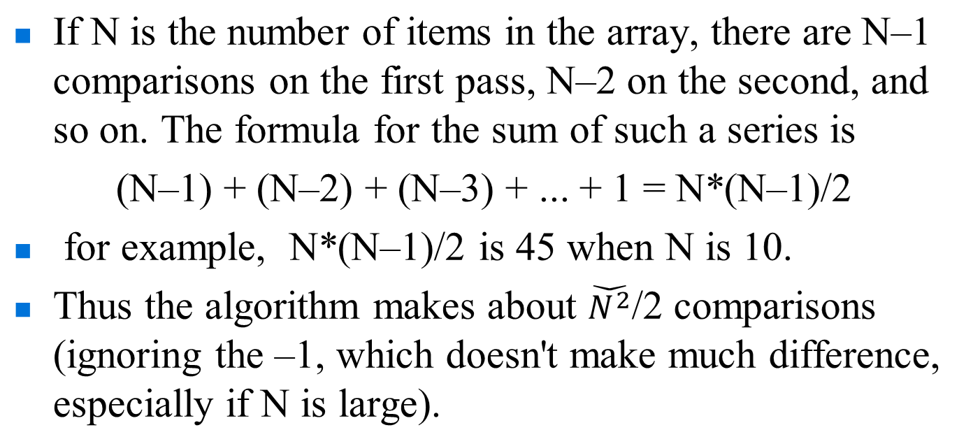
Efficiency of the Bubble Sort
This algorithm is not suitable for large data sets as its average and worst case complexity are of Ο(n²) where n is the number of items.
 The bubble Sort java Program at page 69 in the textbook

Slide 12
Selection Sort (2)
The Concept: https://www.youtube.com/watch?v=79AB11J5BqU
 Selection sort is a simple sorting algorithm. This sorting algorithm is an in-place comparison-based algorithm in which the list is divided into two parts, the sorted part at the left end and the unsorted part at the right end. Initially, the sorted part is empty and the unsorted part is the entire list.
 The smallest element is selected from the unsorted array and swapped with the leftmost element, and that element becomes a part of the sorted array. This process continues moving unsorted array boundary by one element to the right.
 This algorithm is not suitable for large data sets as its average and worst case complexities are of Ο(n²), where n is the number of items

Slide 13
Selection Sort (2)
The selection sort improves on the bubble sort by reducing the number of swaps necessary from Ο(N²) to O(N).
Unfortunately, the number of comparisons remains Ο(N²)
However, the selection sort can still offer a significant improvement for large records that must be physically moved around in memory,
Where the causing the swap time to be much more important than the comparison time

Slide 14
Selection sort
Given an array of length n,
  Search elements 0 through n-1 and select the smallest
    Swap it with the element in location 0
  Search elements 1 through n-1 and select the smallest
    Swap it with the element in location 1
  Search elements 2 through n-1 and select the smallest
    Swap it with the element in location 2
  Search elements 3 through n-1 and select the smallest
    Swap it with the element in location 3
  Continue in this fashion until there’s nothing left to search

Slide 15
Example and analysis of selection sort
The selection sort might swap an array element with itself--this is harmless, and not worth checking for
Analysis:
  The outer loop executes n-1 times
  The inner loop executes about n/2 times on average (from n to 2 times)
  Work done in the inner loop is constant (swap two array elements)
  Time required is roughly (n-1)*(n/2)
  You should recognize this as O(n²)
7
2
8
5
4
2
7
8
5
4
2
4
8
5
7
2
4
5
8
7
2
4
5
7
8

Slide 16
Code for selection sort
public static void selectionSort(int[] a) {
int outer, inner, min;
for (outer = 0; outer < a.length - 1; outer++) {
min = outer;
for (inner = outer + 1; inner < a.length; inner++) {
if (a[inner] < a[min]) {
min = inner;
}
// Invariant: for all i, if outer <= i <= inner, then a[min] <= a[i]
}
// a[min] is least among a[outer]..a[a.length - 1]
int temp = a[outer];
a[outer] = a[min];
a[min] = temp;
// Invariant: for all i <= outer, if i < j then a[i] <= a[j]
}
}

Slide 17
Invariants for selection sort
For the inner loop:
  This loop searches through the array, incrementing inner from its initial value of outer+1 up to a.length-1
  As the loop proceeds, min is set to the index of the smallest number found so far
  Our invariant is:
  for all i such that outer <= i <= inner, a[min] <= a[i]
For the outer (enclosing) loop:
  The loop counts up from outer = 0
  Each time through the loop, the minimum remaining value is put in a[outer]
  Our invariant is:
  for all i <= outer, if i < j then a[i] <= a[j]

Slide 18
Insertion sort (3)
The concept
https://www.youtube.com/watch?v=DFG-XuyPYUQ
This is an in-place comparison-based sorting algorithm. Here, a sub-list is maintained which is always sorted. For example, the lower part of an array is maintained to be sorted. An element which is to be 'insert'ed in this sorted sub-list, has to find its appropriate place and then it has to be inserted there. Hence the name, insertion sort.
The array is searched sequentially and unsorted items are moved and inserted into the sorted sub-list (in the same array). This algorithm is not suitable for large data sets as its average and worst case complexity are of Ο(n²), where n is the number of items.

Slide 19
Insertion sort (3)
The outer loop of insertion sort is:
for (outer = 1; outer < a.length; outer++) {...}
The invariant is that all the elements to the left of outer are sorted with respect to one another
  For all i < outer, j < outer, if i < j then a[i] <= a[j]
  This does not mean they are all in their final correct place; the remaining array elements may need to be inserted
  When we increase outer, a[outer-1] becomes to its left; we must keep the invariant true by inserting a[outer-1] into its proper place
  This means:
    Finding the element’s proper place
    Making room for the inserted element (by shifting over other elements)
    Inserting the element

Slide 20
Analysis of insertion sort
We run once through the outer loop, inserting each of n elements; this is a factor of n
On average, there are n/2 elements already sorted
  The inner loop looks at (and moves) half of these
  This gives a second factor of n/4
Hence, the time required for an insertion sort of an array of n elements is proportional to n²/4
Discarding constants, we find that insertion sort is O(n²)

Slide 21
Why merge sort?
The concept
https://www.youtube.com/watch?v=EeQ8pwjQxTM
Merge sort is a sorting technique based on divide and conquer technique. With worst-case time complexity being Ο(n log n), it is one of the most respected algorithms.
Merge sort first divides the array into equal halves and then combines them in a sorted manner.

Slide 22
Merge sort
30
24
7
12
14
4
20
21
33
38
10
55
9
23
28
16
Split the array into two or more parts
30
24
7
12
14
4
20
21
33
38
10
55
9
23
28
16
Sort each part individually
4
7
12
14
20
21
24
30
9
10
16
23
28
33
38
55
Merge
4
7
9
10
12
14
16
20
21
23
24
28
30
33
38
55

Slide 23
Using merge sort for large data sets
Very roughly, here’s how to sort large amounts of data:
  Repeat:
    Read in as much data as fits in memory
    Sort it, using a fast sorting algorithm (quicksort may be a good choice)
    Write out the sorted data to a new file
  After all the data has been written into smaller, individually sorted files:
    Read in the initial portion of each sorted file into individual arrays
    Start merging the arrays
    Whenever an array becomes empty, read in more data from its file
    Every so often, write the destination array to the (one) final output file
When you are done, you will have one (large) sorted file

